Slide 1
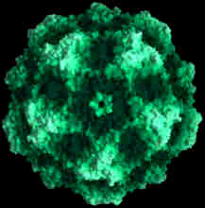
Canine Parvovirus
CPV. CPV2. CPV2a. CPV2b. CPV2c.
Maegan Fox

Slide 2
History:
The original canine parvovirus was discovered in 1967 and called "CPV-1" or "the minute virus of canines.“ However, it did not represent much of a medical threat except to newborn puppies but by 1978, a new variant known as "CPV-2" appeared in the U.S.
Early beliefs claimed CPV-2 to be a mutation from the feline panleukopenia.
Two more strains of canine parvovirus CPV2a and CPV2b were identified in 1979 and 1984 respectively. Most cases of canine parvovirus infection are believed to be caused by these two strains, which have replaced the original strain, and the present day virus is different from the one originally discovered although they are indistinguishable by most routine tests. A third type, CPV2c (a Glu-426 mutant), has been discovered in Italy, Vietnam, and Spain.

Slide 3
Etiology/Cause:
Parvo is an extremely hardy virus that is able to withstand harsh environmental conditions and most household cleaners/disinfectants and can survive on the premises for months, even as long as a year.
Highly contagious.
Mainly affects young puppies that are 6-20 wks old due to a limbo period of decreased antibody protection from the mother and the inadequate vaccination protection for the young pups.
Adult dogs may be asymptomatic carriers and shed the virus periodically.
Mortality rate is variable: 16-48%.

Slide 4
Signalment:
Parvo affects dogs of all ages, but most cases occur in puppies 6 to 20 weeks of age.
Doberman Pinschers and Rottweilers appear to acquire the infection more readily and experience more severe symptoms. The reason for lower resistance in these breeds is unknown.
>Other various black and tan dogs included.

Slide 5
How is Parvovirus Spread?
CPV-2 is highly contagious and is spread by direct dog-to-dog contact and contact with contaminated feces, environments or people. It is readily transmitted from place to place on the hair or feet of dogs or via contaminated cages, shoes or other objects.
> The virus can also contaminate kennel surfaces, food and water bowls, collars and leashes and the hands and clothing of people who handle infected dogs.
It is resistant to heat, cold, humidity, and drying, and can survive in the environment for long periods of time. Even trace amounts of feces containing parvovirus may serve as environmental reservoirs of the virus and infect other dogs that come into the infected environment.
Can I get Parvovirus??
>There is no documented evidence to suggest that humans may become infected with CPV.

Slide 6

What Should I Look For?
Lethargy
Vomiting
Fever
Diarrhea (bloody/mucus)
Dehydration
Anemia
Endotoxemia
Intussusception (in some cases)
Death
Dehydration can lead to critically affected electrolyte balance.
Because intestinal lining is being compromised, blood and proteins leaking into intestines will cause anemia.
Endotoxins escaping into the bloodstream will result in Endotoxemia.
Most deaths from parvovirus occur within 48 to 72 hours following the onset of clinical signs.

Slide 7
Diagnostic Tests:
The Enzyme Linked ImmunoSorbent Assay (ELISA) test has become a common test for parvovirus. The ELISA test kit is used to detect parvovirus in a dog's stools, and is performed in the vet's office in about 15 minutes. Because this test is not 100% sensitive or specific, your veterinarian may recommend additional tests and blood work.
PCR (polymerase chain reaction) testing has been shown to be a very effective and sensitive way to detect canine parvovirus. Dogs that have been experimentally exposed to parvo had positive fecal PCR results from day three to day fourteen after exposure. This gives you a much bigger window of opportunity to diagnose the virus. The PCR test will also find the presence of fecal parvo DNA even when an antigen test (ELISA) showed a negative result.
> Real-time PCR is the newest technology using a minor groove binder (MGB) probe assay to specifically identify CPV-2 vaccine strains and field strain types (2a, 2b, and 2c). It is based on the TaqMan technology, and this real-time PCR has been proven to be even more specific, sensitive, and reproducible than other conventional methods such as: hemagglutination assays, immunochromatographic tests, viral isolation, and even gel-based PCR

Slide 8



Recommended Treatment:
In all but the most mild cases, hospitalization is essential to correct dehydration and electrolyte imbalances. Intravenous fluids and medications to control vomiting and diarrhea are often required. More severe cases may require blood plasma transfusions and other intensive care.
No specific drug is available that will kill the virus in infected dogs, and treatment is intended to support the dog’s body systems until the dog’s immune system can fight off the viral infection. Treatment should be started immediately and consists primarily of efforts to combat dehydration by replacing electrolyte and fluid losses, controlling vomiting and diarrhea, and preventing secondary infections.
Sick dogs should be kept warm and receive good nursing care. When a dog develops parvo, treatment can be very expensive, and the dog may die despite aggressive treatment. Early recognition and aggressive treatment are very important in successful outcomes.

Slide 9
Prognosis:
For dogs that receive prompt medical treatment and survive acute infection, the prognosis usually is good. Severe infection often has a poor outcome. Puppies that survive CPV-2 infection usually do so within 7 days, but the younger the pups are when they succumb to the disease the poorer the prognosis.
> Following CPV infection, dogs may be contagious for up to 2 months.
Mortality is high in cardiac CPV and is about 10% in the more common, intestinal CPV.
The outcome depends upon the virulence of the specific strain of parvovirus, the age and immune status of the dog, and how quickly the treatment is started. Most puppies who are under good veterinary care recover without complications.

Slide 10
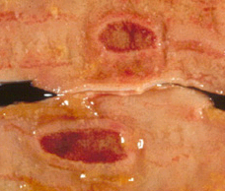
Pathologic Lesions :
Peyer's Patches :
Ovoid, elevated patches of closely packed lymphoid follicles in the mucosa and submucosa of the small intestine. Also called aggregated lymphoid follicles.

Slide 11
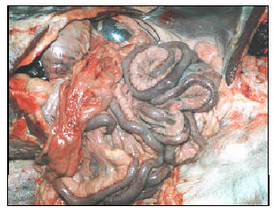
Pathologic Lesions cont.
Typical hemorrhagic enteritis in a CPV positive dog, serosal hemorrhages and hyperemic mesenterial vessels

Slide 12
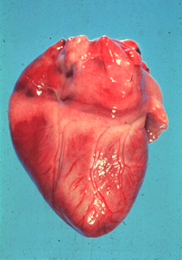
Pathologic Lesions cont.
Heart from puppy which died of parvoviral myocarditis. Note the necrotic areas in myocardium.

Slide 13
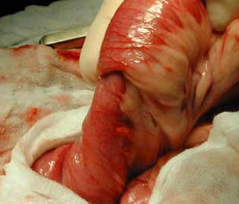
Pathologic Lesions cont.
Intussusception – when one segment of the intestine (the intussusceptum) telescopes into the lumen of and adjacent segment of intestine (the intussuscipiens).

Slide 14


How Can I Protect My Dog?
The most effective disinfectant is household bleach in a 1:32 dilution.
>The bleach must be left on the contaminated surface for 20 minutes before being rinsed.
              Vaccinations starting as early as 8 weeks of age and ending by 16-20 weeks of age.
              >Recommendations are for a booster a year from the initial vaccine series and then revaccination every three years.
              Until a puppy has received its complete series of vaccinations, pet owners should use caution when bringing their pet to places where young puppies congregate.

Slide 15
Client Education:
Make sure you have your new puppy vaccinated on a proper schedule. See your veterinarian.
Many puppies can survive parvovirus infection with proper treatment.
Treatment may be expensive and require a hospital stay of several weeks.
Other dogs in the house may become infected if not adequately vaccinated.
The virus can survive long term in the environment.
Keep puppies free of intestinal parasites. Intestinal parasites appear to predispose dogs to parvovirus infection.

Slide 16
References:
http://www.marvistavet.com/html/what_is_parvo.html
http://en.wikipedia.org/wiki/Canine_parvovirus
http://pets.webmd.com/dogs/parvovirus-in-dogs
http://cal.vet.upenn.edu/projects/pathterm2/shapes/ovoid.htm
Summers, Alleice. Common Diseases of Companion Animals. St. Louis, MO: Elsevier Mosby, 2007. 238-39. Print.

