Slide 1
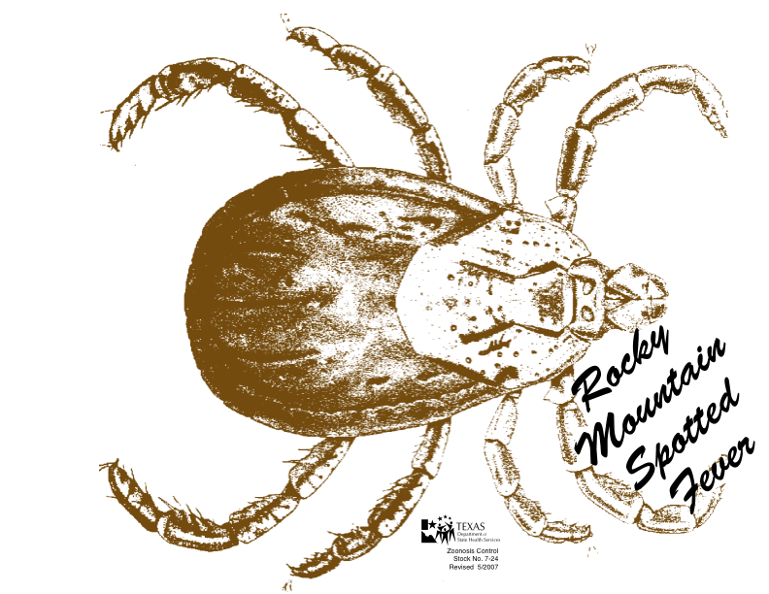
By: Kim Wright Thursday, July 21 2011

Slide 2
Etiology
Rocky Mountain Spotted Fever (RMSF) is a vector-borne disease caused by infection from Rickettsia rickettsii
  A bacteria in the family Rickettsiascae
  Gram negative
  Obligate intracellular
  Pleomorphic (can take on different forms depending on its environment)
  Causes vascular endothelial injury
Bacteria is spread through the saliva of two main types of ticks:
  Dermacentor variabilis (American dog tick)
  Dermacentor andersoni (Rocky Mountain wood tick)
  Possible vector in the Southwest: Amblyomma Americanum (Lone Star tick)

Slide 3
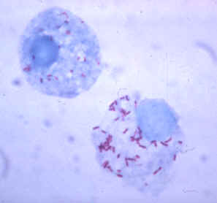
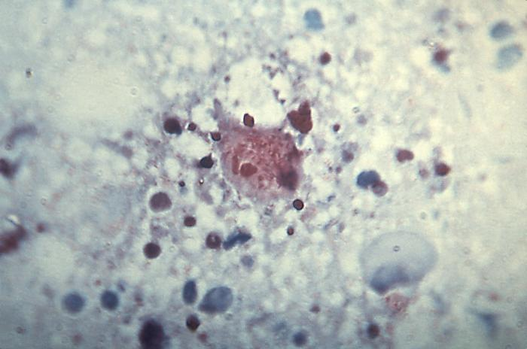
Rickettsia rickettsii bacteria

Slide 4
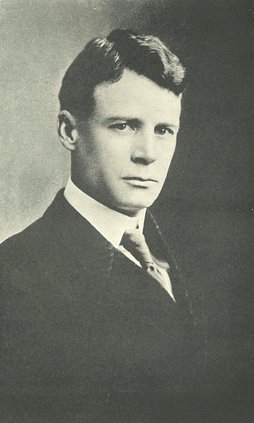
History of Disease
First discovered in 1896 in the Snake River Valley of Idaho and originally called “black measles” because of the characteristic rash
Howard Ricketts, a pathologist at the University of Chicago, was able to isolate the responsible organism as well as its vector in 1900.
Most prevalent from April to September
Most commonly seen in Oklahoma and North Carolina
Not recognized in dogs until the 1970s
Ironically, RMSF is relatively rare in the Rocky Mountain region.

Slide 5
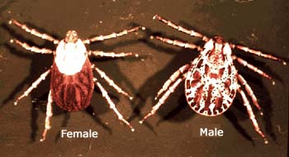
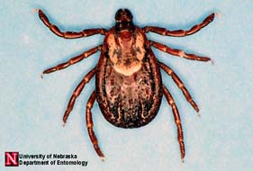
American dog tick (Dermacentor variabilis)
Rocky Mountain wood tick (Dermacentor andersoni)

Slide 6
Transmission
The most common way a tick becomes infected is transovarilly – the pregnant female passes the disease to her offspring.
Ticks can also acquire the disease through the transfer of bodily fluids during mating or by feeding on small mammals that have been infected.
During feeding, a tick infects the host with its saliva.
In order for the animal to become infected the tick must be attached for between 5-20 hours.
Once the host is infected with the Rickettsia rickettsii organism there is a 2-14 day incubation period before it invades the animal’s circulatory system.
Once inside the endothelial cells, the organism begins to replicate.

Slide 7
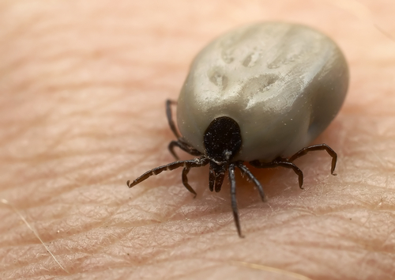
Engorged tick

Slide 8
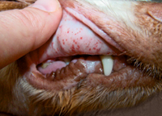
Clinical Signs
Fever, anorexia, and depression are the most common clinical signs.
Others include:
  Scleral injection
  Coughing
  Nasal discharge
  Dyspnea
  Diarrhea
  Vomiting
  Seizures
  Edema of the face or extremities
  Petechia of the mucous membranes

Slide 9
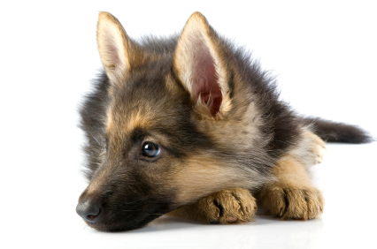
Signalment
Purebred dogs are more likely to show signs of the disease than mixed-breed dogs.
German Shepherd Dogs appear to be the most common breed infected.
English Springer Spaniels with a phosphofructokinase deficiency generally have more severe clinical signs.
Age and sex of the animal do not play a specific role in the commonality or severity of the disease.

Slide 10

Pathologic Lesions of RMSF
Ocular lesions resulting from vasculitis and hemorrhage
  Most common is retinal hemorrhage
Petechia in various organs including the brain, heart, testes, and lymph nodes
Characteristic rash in humans

Slide 11
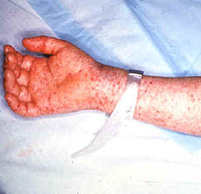
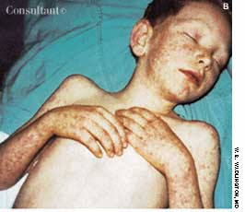
Transmission to Humans
Rocky Mountain Spotted Fever is a zoonotic disease.
It infects humans the same way that it does animals: through the saliva of an infected tick.
It can also be transmitted by crushing an infected tick and being exposed to its tissues, fluid, or feces through breaks in the skin.
Dogs and humans are the only mammals that show clinical signs or symptoms of infection.
In humans, symptoms include fever, chills, severe headache, cough, muscle pain, nausea, vomiting, diarrhea, edema, and a rash that appears several days after the onset of symptoms.

Slide 12
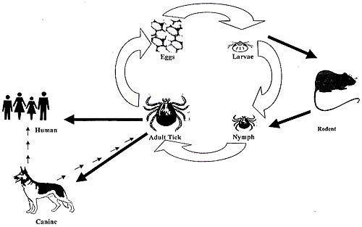

Slide 13

Diagnostic Tests
Serologic testing is the best way to detect infection.
  Indirect fluorescent antibody test
  The presence of a four-fold increase in titer in samples taken more than three weeks apart
A less practical test is a PCR of a biopsy or skin lesion sample
Diagnosis is often made retrospectively by evaluating the patient’s response to antibiotic treatment.

Slide 14
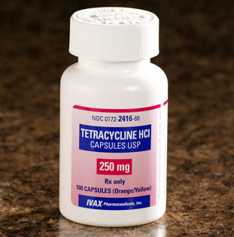
Treatment
Rocky Mountain Spotted Fever can be treated with the antibiotics tetracycline or doxycycline.
Antibiotics should be started as soon as a diagnosis can be made based on clinical signs.
Response is usually seen within 24-48 hours of starting antibiotics, but in severe cases with necrosis or thrombosis, treatment may not be effective.
Follow-up testing should be performed to ensure the patient fully recovers.

Slide 15

Prognosis
RMSF is a detrimental disease that can be fatal if not treated in a timely manner.
Once CNS signs can be seen, the mortality rate is very high.
The complete course of antibiotics should be taken in order to completely rid the animal of the disease.
Once a dog has recovered from RMSF they have effective immunity against re-infection.

Slide 16

Prevention
Limit the dog’s exposure to tick-infested areas especially from the months of April to September.
Always remove ticks immediately!
Use a flea and tick preventative such as Frontline Plus or K9 Advantix II

Slide 17
Client Education
There is no vaccine available for the prevention of Rocky Mountain Spotted Fever.
RMSF can be a very fatal disease, but it is also very preventable.
The disease affects dogs as well as humans, so precaution must be taken when removing ticks.
Pay attention to mild changes in your dog’s behavior and mannerisms especially if they are exposed to tick-infested areas.

Slide 18
References
Summers, Alleice. Common Diseases of Companion Animals. St. Louis, Missouri. 2007.
http://www.cdc.gov/niosh/topics/tick-borne/
http://www.cfsph.iastate.edu/
http://www.vet.uga.edu/vpp/clerk/otis/

Slide 19

Questions???

