Slide 1

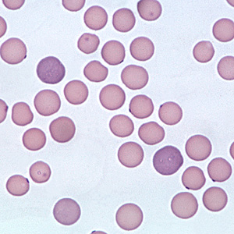
Jackie Lester
Yasmin Lutz
Hemobartonellosis
(Feline Infectious
Anemia)
Group B

Slide 2
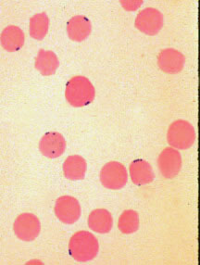
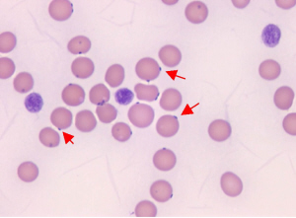
History
A parasitic disease that was first described in the United States in 1953.
Recently, two genotypes have been identified. The small variant (Hemobartonella felis) and large variant (Mycoplasma haemofelis.)

Slide 3
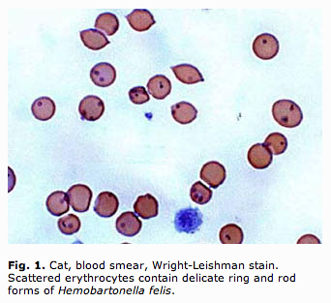
Etiology
Hemabartonellosis is caused by infection of the red blood cell by Hemobartonella felis or Mycoplasma haemofelis (epicellular bacterial parasites of feline erythrocytes.)
The organisms are recognized as small blue cocci, rings, or rods on the edges or across the membrane of red blood cells.
The immune system detects the parasite and then tries to destroy it, along with the red blood cell to which it is attached. The anemia that can be caused by this parasite is called Feline Infectious Anemia (FIA)

Slide 4
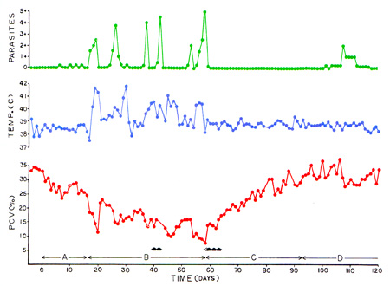
Four phases of Hemabartonellosis
1st phase:
pre-parasitemic phase
lasts from 2 to 21 days
cats are infected but don't show clinical signs
the organism is not detectable in the bloodstream
2nd phase:
acute phase
lasts from 2 to 4 months
clinical signs and parasitemia occur occasionally, severity varies
some are asymptomatic, other cats have profound anemia and illness, which can be fatal
First
Second
Third
Fourth
4th phase:
carrier phase
can last for years
appear clinically normal
organism is rarely detectable
3rd phase:
recovery phase
can vary in duration
can remain mildly anemic and asymptomatic
phases of parasitemia are minimal

Slide 5

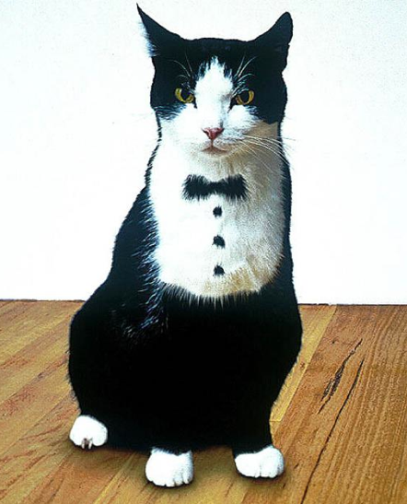

Signalment
Age: Cats less than four years of age are at higher risk, but all ages can get it.
Sex: Male cats are typically more aggressive which makes them slightly more prone.
Cats with improper vaccinations, feline leukemia, feline immunodeficiency virus, and anemia are more at risk for developing this parasite.
Those with a history of repeated cat-bite wounds are also more at risk.
Breed: No known breed is of higher risk.
Geographic: Outdoor cats are of higher risk.

Slide 6
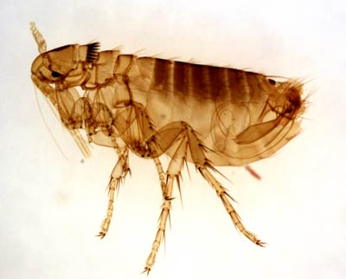
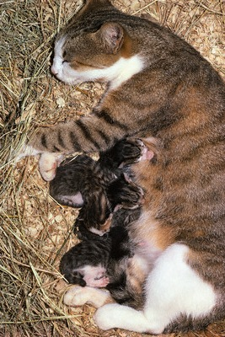
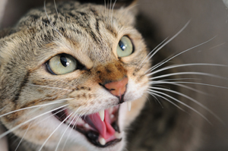
Transmission
Hemabartonellosis is believed to be transmitted/spread through:
Blood sucking insects (fleas, ticks, mosquitoes)
Direct contact between cats when fighting, specifically via open bite wounds.
In utero or from nursing kittens
Intrauterine transmission has also been suspected.
(Transmission in naturally occurring infections have been difficult to clarify fully.)

Slide 7
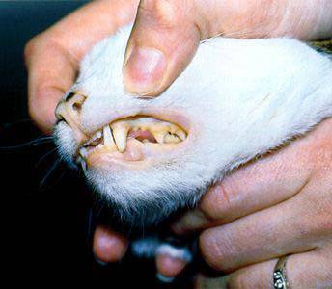


Clinical signs may develop slowly with chronic disease or develop acutely.
Clinical Signs
Depression
Lethargy
Fever
Tachycardia/tachypnea
Icterus/pallor
Weight loss/anorexia
Anemia
Sensitive abdomen (splenomegaly and hepatomegaly)

Slide 8

Diagnostic tests and results
Hemabartonellosis is diagnosed with a blood smear analysis, stained with Wright-Giemsa, and a CBC. They will reveal epicellular coccoid or ring-shaped organisms on the erythrocytes.
A Coombs’ Test should also be done, which may test positive.
Because the parasite appears in cycles, it is not always present in the blood stream. This means that multiple tests may be required for an accurate diagnosis.
If the cat is anemic and a large number of Hemabartonella felis are present, Feline Infectious Anemia is diagnosed.

Slide 9
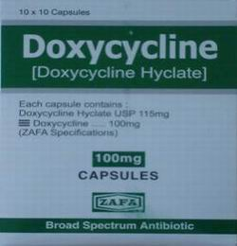
Treatment
Hemabartonellosis is simple and usually successful if treated with the use of antibiotics such as:
Doxycycline
Tetracycline
Oxytetracycline
Enrofloxacin
Glucocorticoids
Antibiotics don’t remove the organism completely but suppress replication of the parasite.
A blood transfusion may be necessary in severe cases of anemia.
Because antibiotics don’t remove the organism completely, infected cats who recover will still remain chronic carriers and may be susceptible to relapse during times of stress or illness.

Slide 10

Prognosis
Even without treatment almost 65% of acutely ill cats will survive.
If Hemabartonellosis is the primary problem, the prognosis for recovery is very good.
75% of cats will survive if diagnosis is made and treatment has occurred.
Prognosis is worse if Feline Leukemia is primary problem.
Blood transfusions plus antibiotic therapy does not induce long-term remission.

Slide 11
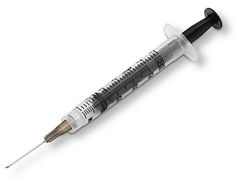
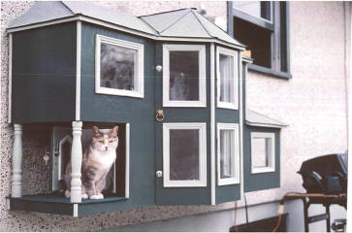
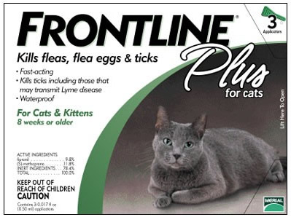
Prevention
There is no vaccine for Hemabartonellosis, but keeping them up to date on their Combo vaccines could prevent complications with FeLV and hemabartonella felis.
Because blood sucking parasites are the vectors for this parasite, using proper flea and tick control will also lessen the risk of your cat being infected.
Keeping your cat in doors can prevent cat fights, ultimately preventing any direct contact with other infected cats via open wounds.

Slide 12


Client Education
Flea and tick prevention could be essential in the prevention of Hemabartonellosis.
Keeping your cat inside, or keeping an eye on your cat when you let them out could prevent cat-bite wounds.
Once treated your cat will still remain a chronic carrier and is still susceptible to relapse in times of stress or illness.
PREVENTION
IS
KEY!!!!
A HEALTHY KITTY IS A HAPPY KITTY!

Slide 13

REFERENCES:
http://ahdc.vet.cornell.edu/clinpath/modules/rbcmorph/mycoplasma-felis.htm
http://caremoreanimalhospital.vetsuite.com/Templates/ContentPages/Articles/ViewArticleContent.aspx?Id=300
http://www.vet.uga.edu/VPP/clerk/Cowgill/Index.php
http://www.sbvet.net/ClientEducation_FIA.html
http://www.merckvetmanual.com/mvm/index.jsp?cfile=htm/bc/10406.htm
THE END!

