Slide 1
Toxoplasmosis

Slide 2
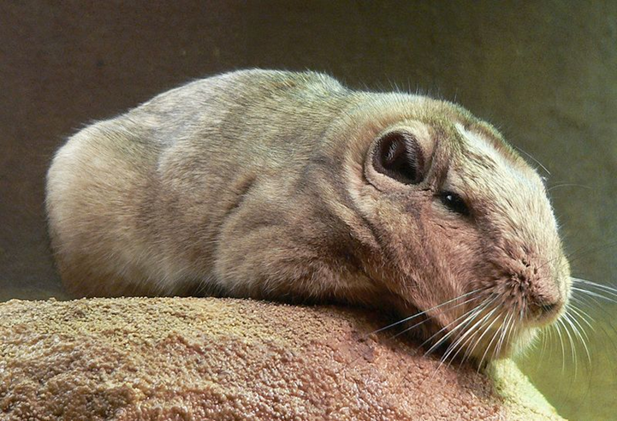
History
Toxoplasmosis is a Zoonotic disease, caused by Toxoplasma gondii, an obligate intracellular parasite.
Toxoplasma gondii was first discovered in 1908 by Nicolle and Manceaux, in Tunis, on a Gundi (Ctenodoactylus gundi).
It wasn't until 1939 that Wolf, Cowen and Paige were to conclude that toxoplasma gondii had an effect on humans.

Slide 3
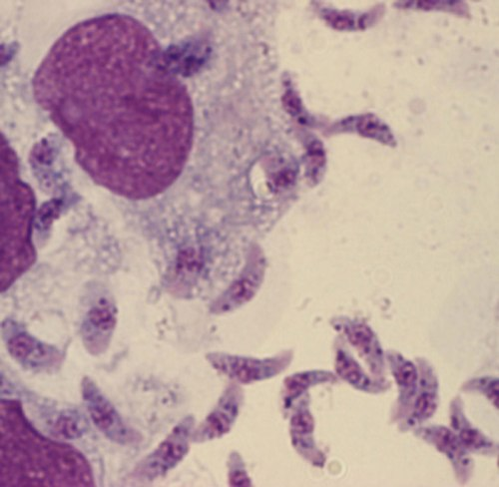
Etiology
Toxoplasma gondii is an obligate intracellular parasite of the coccidia subclass displaying typical sexual and asexual life cycles.
T. Gondii causes Toxoplasmosis

Slide 4
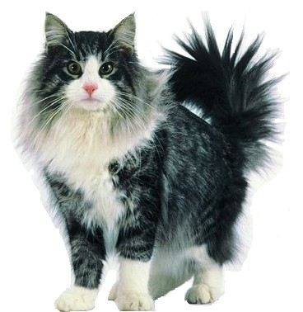
Toxoplasmosis facts
The feline is the only definitive host, but other warm blooded animals, including humans, can serve as an intermediate host. It does not discriminate in any way on sex, age or species. However it is rare in dogs.
Toxoplasmosis is a world spread disease. Alone in the US around 60 million people carry the toxoplasma parasite without even showing symptoms. It is a big concern for pregnant women, and immune-compromised people.

Slide 5

Toxoplasmosis is caused by ingesting contaminated vegetables, water, fruit and undercooked/raw meat.
By ingesting contaminated feces, for example after cleaning out a litterbox.
Or by doing garden work, and not maintaining a healthy hand washing regime.
What causes Toxoplasmosis

Slide 6

Signalment
Toxoplasmosis is found in most warm blooded animals of any age, sex or species.
The feline is the only definitive host, but humans and other animals can serve as an intermediate host.
In the US it is the leading food-born disease causing death.
It can be very detrimental for pregnant women or animals, causing abortions around the 3rd trimester.

Slide 7

Transmission
Toxoplasmosis is zoonotic
Transmission can occur in 3 ways
  Fecal-oral
  Eating contaminated meat/prey
  Transplacental
The parasite can only produce oocytes (or eggs) when infecting a cat. The organism then multiplies in the wall of the small intestine and produces oocysts during the intraintestinal infection cycle.

Slide 8
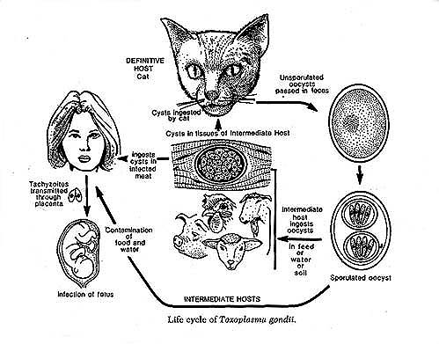

Slide 9
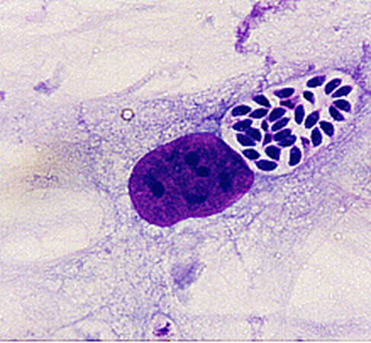
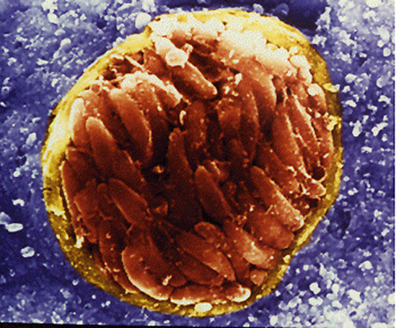
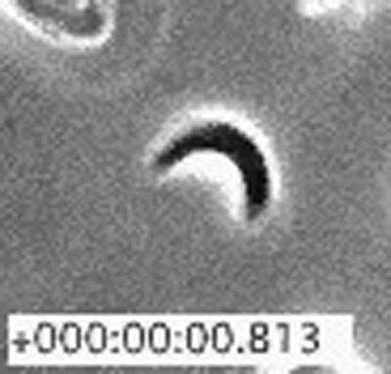
There are three forms of Toxoplasma gondii
Tachyzoite – Rapidly reproducing form
Bradyzoite – A slower reproducing form, contained in tissue
Sporozoite – Contained in oocysts

Slide 10
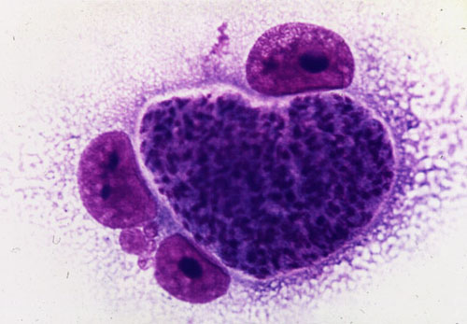
Tachyzoite
Tachyzoites invade cells in the body in order to multiply. They invade a cell, multiply themselves, destroy the cell, and this releases more tachyzoites to infect other cells.
Tachyzoites are seen in many tissues and organs throughout an infected body during the acute phase of the disease.
The acute phase is also called the extraintestinal phase because it can effect cells outside the intestines.
Only cats show the intestinal phase of the infection.
Stained tachyzoite

Slide 11
Bradyzoites
Two or three weeks after the first infection, the Toxoplasma microorganism begins to divide more slowly and a protective membrane forms around the parasite cells.
The cysts containing the parasite cells are called zoitocysts and the cells inside the cysts are called bradyzoites.
The tissue cysts are formed primarily in brain, eye, heart muscle, and skeletal muscle.
Bradyzoites persist in tissue for many years, possibly for the life of the host.

Slide 12
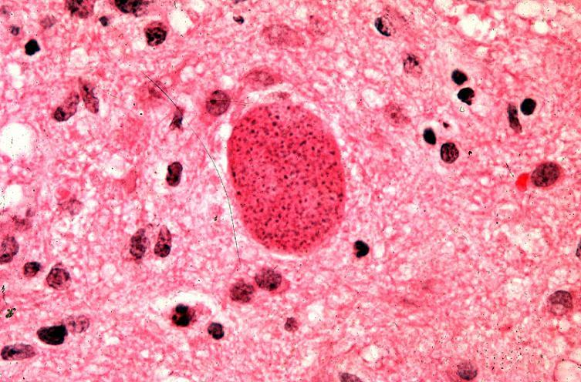
Bradyzoite

Slide 13
Oocysts
In cats, the Toxoplasma parasites infect the lining of the small intestine where they reproduce asexually.
After a few days of rapid reproduction the cells transform into a sexual form, combine, and become enclosed in a cyst called an oocyst.
Oocysts contain the sporozoite form of the Toxoplasma parasite.
Oocysts are found in both wild and domestic cats but not in any other animals or birds.

Slide 14
Oocysts cont.
Animals become infected by ingesting food contaminated with oocysts from feces or with tissue cysts (bradyzoite) from the flesh of infected animals.
Infected cats shed millions of oocysts in their feces during the two-week period of the intestinal phase of the infection (i.e., when asexual reproduction of the Toxoplasma microorganisms occurs).
These oocysts can survive in soil for several months and are the major source of infection.
Once swallowed, the oocyst burst in the intestines and spreads to the rest of the body through the bloodstream.

Slide 15
http://animal.discovery.com/videos/monsters-inside-me-toxoplasma-parasite.html

Slide 16

Clinical signs & symptoms
Fever
Loss of appetite
Lethargy
Other symptoms may occur depending on whether the infection is acute or chronic, and where in the body the parasite is found.
In cats it is most commonly seen effecting the lungs and eyes.
And in the dog, the gastrointestinal, neurological and the respiratory system.

Slide 17
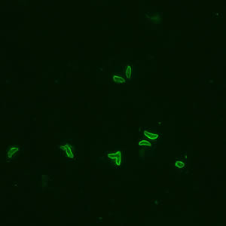
Diagnosis
History
Serology testing – measuring the IgM & IgG anti-bodies
Sabin-Feldman Dye Test (DT)
Differential agglutination test (also known as the "AC/HS test")

Slide 18

Treatment
The best treatment is prevention, by not feeding animals raw meat
There is no need for treatment in a healthy animal.
For an immune-compromised animal a 2-3 week treatment of clindamycin is administered.

Slide 19
Prognosis
For healthy animals and humans the prognosis is good. The disease should be hibernating and not causing any damage.
For individuals with weakened immune systems, the prognosis is not good. The disease has to be kept down with medicine, and complications can occur depending or what tissues of the body are being effected.
For example, if toxoplasmosis is effecting the eye, the body will try and attack the foreign invader, which can lead to blindness.
Immune-compromised hosts infected with toxoplasmosis may have encephalitis, pneumonitis and myocarditis as manifestations of the infection.
These infections are usually fatal if not recognized and treated.

Slide 20
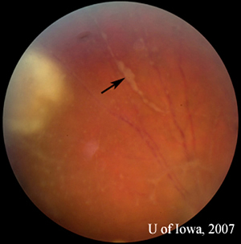
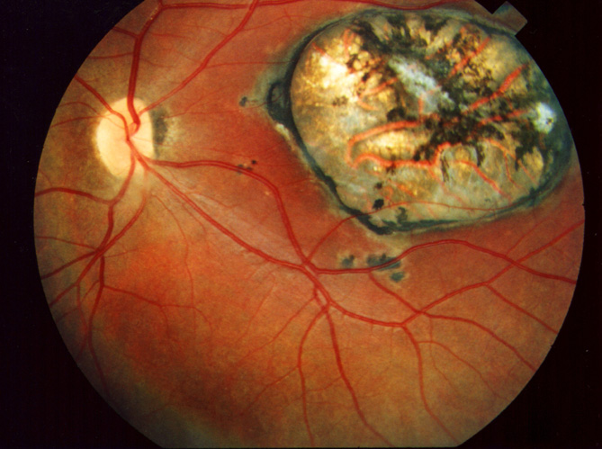
Pathologic lesions of disease
EYE

Slide 21
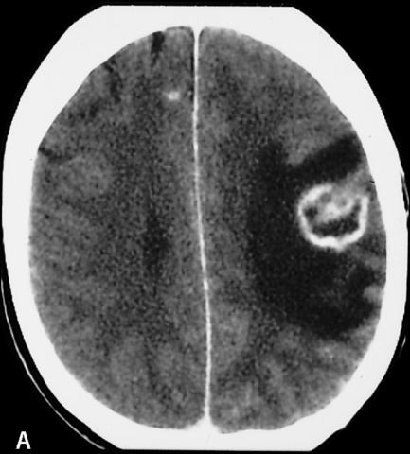

Slide 22
Prevention
Avoid eating raw meat, unwashed fruit and vegetables
Keep children's sand boxes covered.
Wash hands after dealing with raw meat, gardening, and changing litterboxes.
Change litterboxes daily (the oocytes shedded in the feces don't become infectious for 1-5 days)
Don't feed animals raw meat.
If pregnant wear gloves when changing litterboxes, and keep cats indoors to insure they don't hunt and eat contaminated prey/meat.
There is only one vaccine available. It is exclusively for sheep and it is only approved for use in Great Britain

Slide 23
Client education
What is toxoplasmosis? It is a disease caused by the parasite toxoplasma gondii. It is found anywhere in the world, effecting any species, even though the cat is required for the organism's lifecycle.
Can my indoor cat get toxoplasmosis? If you have an indoor cat that is fed only a commercially produced pet food the cat should not be at risk of getting toxoplasmosis. Indoor/outdoor cats are at risk because we can not track their every move to insure they don't eat contaminated meat/prey.

Slide 24
Client education Cont.
Can I get toxoplasmosis? Yes, humans can get toxoplasmosis, it is a zoonotic disease.
Will it be harmful to me as a human? In healthy humans it shouldn't be harmful.
If you get toxoplasmosis do you have it for the rest of your life? Yes, toxoplasmosis will stay in your system for the rest of your life. As long as you are not immune-compromised the disease shouldn't do any harm.
Can you pass toxoplasmosis to your baby if pregnant, and should I get rid of my cat? Toxoplasmosis can be transferred transplacentally, meaning it can be transferred from mother to child in the womb. It doesn’t mean you have to get rid of your cat. Keep the cat as an indoor cat, and wear gloves/wash hands after changing litter (or simplify things and get someone else to change the litterbox daily.)

Slide 25
Side notes
Victoria, British Colombia suffered the first documented outbreak of Toxoplasmosis in 1997
It was speculated that feline feces contaminated a surface water reservoir with Toxoplasma gondii oocysts. A thorough investigation of the watershed in Victoria followed the outbreak, and evidence proved that cats, cougars and deer mice contaminated with oocytes would shed them near the water's edge. This made the water contaminated, and infected more than 110 people with toxoplasmosis, including 12 newborns. Further investigation was made into the food distributors in Victoria, but no evidence of contamination was found.

Slide 26
Side note continued
In 1995 the British Columbia Center for Disease Control became aware of a sudden increase in acute toxoplasmosis in Victoria, where two separate and independent ophthalmologists diagnosed seven cases of acute toxoplasmosis with retinitis. Neither ophthalmologist had any other cases of toxoplasmosis in the previous 5 years.
The threat of epidemics is even more concerning because of studies which have been conducted for more than 30 years researching the bond between toxoplasmosis and schizophrenia.
Studies of rats and mice have shown that infection with toxoplasmosis causes them to have higher rates of mental retardation, impaired memory and impaired learning.

Slide 27
References
http://www.cdc.gov/ncidod/eid/vol9no11/03-0143.htm
http://www.stanleyresearch.org/dnn/LaboratoryofDevelopmentalNeurovirology/ToxoplasmosisSchizophreniaResearch/tabid/172/Default.aspx
http://ci.vbi.vt.edu/pathinfo/pathogens/gondii.html
http://www.ccohs.ca/oshanswers/diseases/toxoplasmosis.html
http://animal.discovery.com/videos/monsters-inside-me-toxoplasma-parasite.html

